Slide 1
Calculating the Determinant using LU Decomposition
Team Members: Angel Badillo and Chad Callender

Slide 2
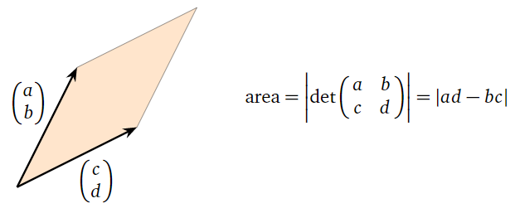
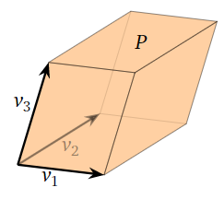
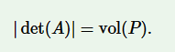
Determinant Applications
Area of Parallelogram
Singularity and Invertibility
Cardinality of a solution set in a system of linear equations
Used to solve for the inverse of a non-singular matrix.
Volume of regions in R^{n}
Volume of Parallelepipeds

Slide 3
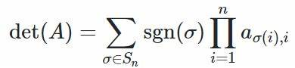
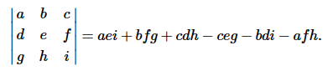
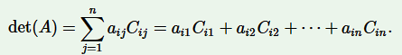
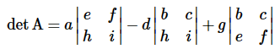
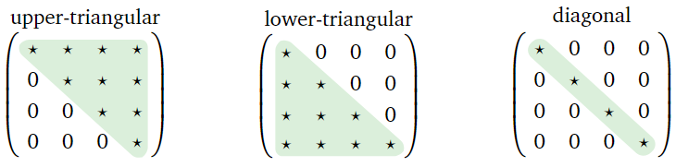
About the Determinant
Leibniz Formula
A scalar value from the real valued function det on the set of square matrices
Determinant rules:
det(A) = 0 means not invertible.
det(A*B) = det(A)*det(B).
Many formulas for calculating the determinant:
Leibniz formula
Cofactor Expansion
Gaussian Elimination
Determinant of a triangular matrix is the product of the diagonal entries.
Cofactor Expansion
Triangular Matrices

Slide 4
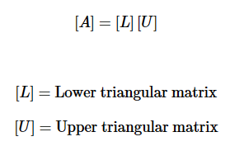
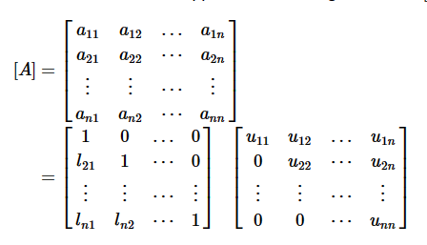
About LU Decomposition
Lower-Upper Decomposition
Any square matrix can be decomposed into:
Lower triangular matrix
Upper triangular matrix
Can be done using:
Gaussian Elimination
Doolittle Algorithm
In MATLAB, LU decomposition is used for the computation of determinants, inverse matrices, and the symbolic matrix division operators.

Slide 5
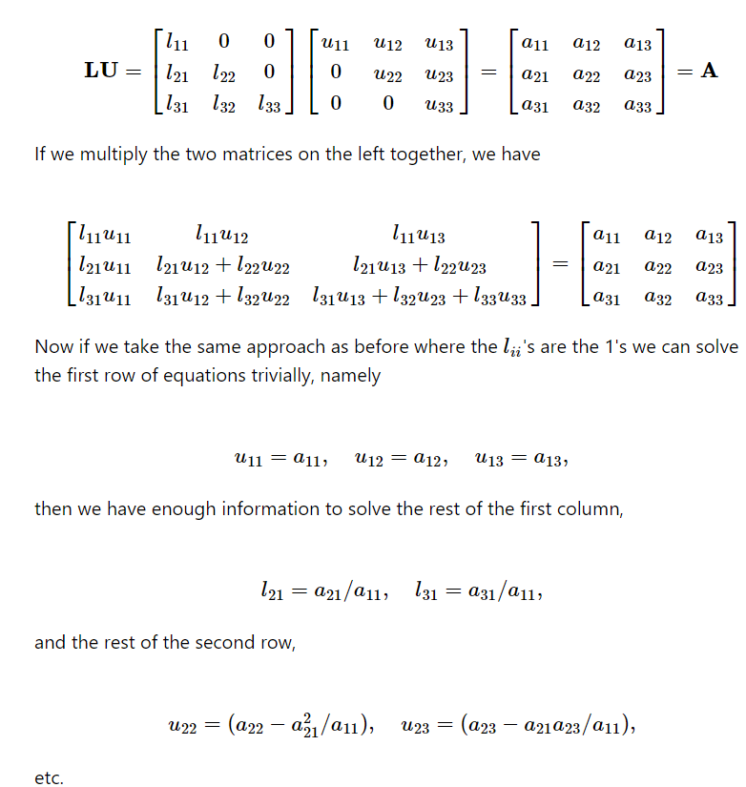
Doolittle’s Algorithm
Suppose A ∊ F^{n,n}. Then A can be decomposed into matrices L, U ∊ F^{n,n} where A = LU.

Slide 6
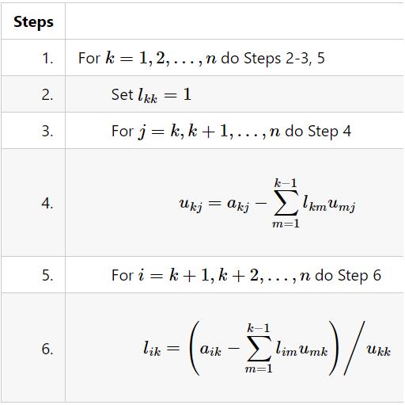
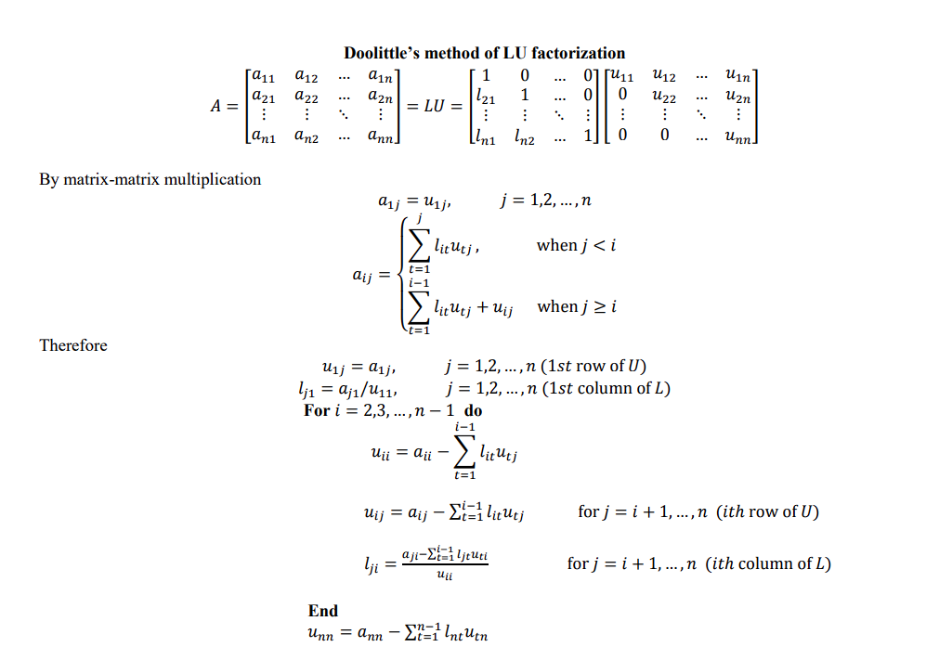
Sequential Approach

Slide 7
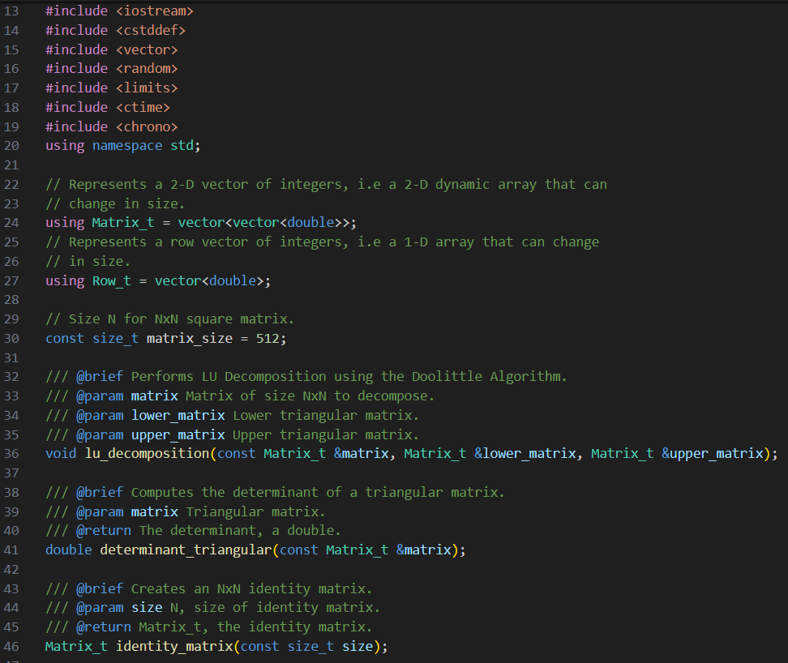
Serial C++ Code

Slide 8
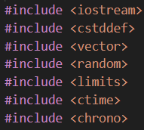
Serial C++ Code

Slide 9
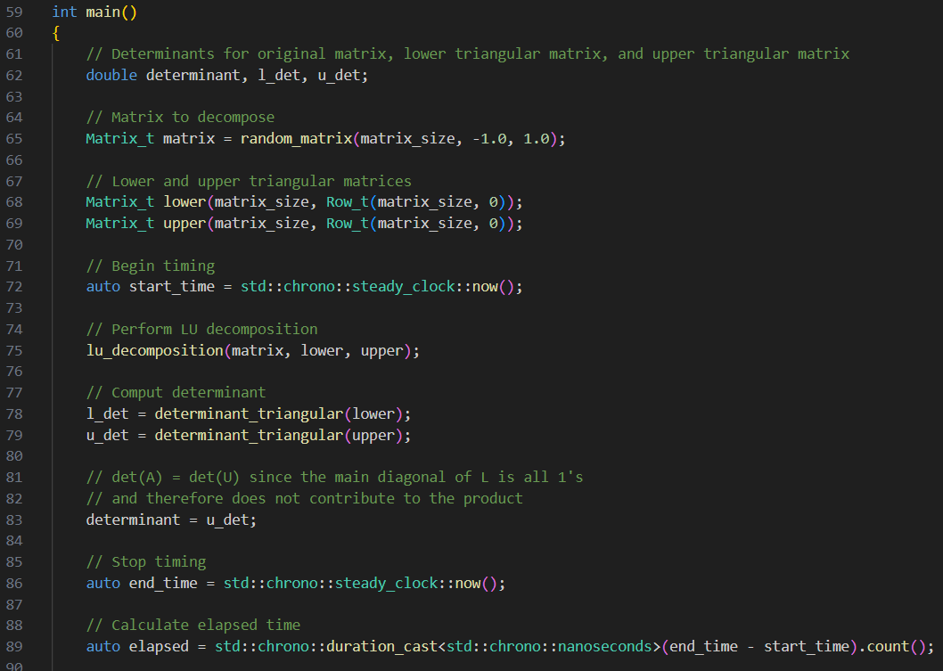
Serial C++ Code

Slide 10
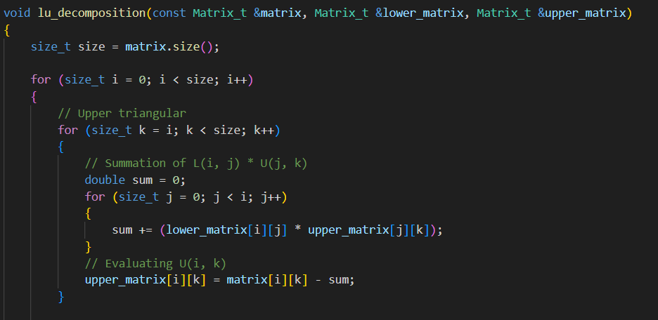
Serial C++ Code

Slide 11
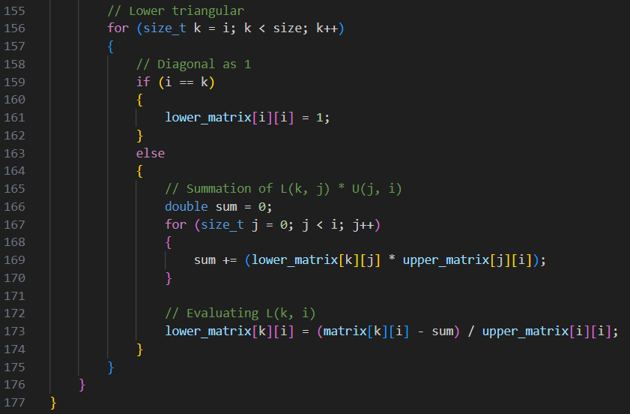
Serial C++ Code

Slide 12
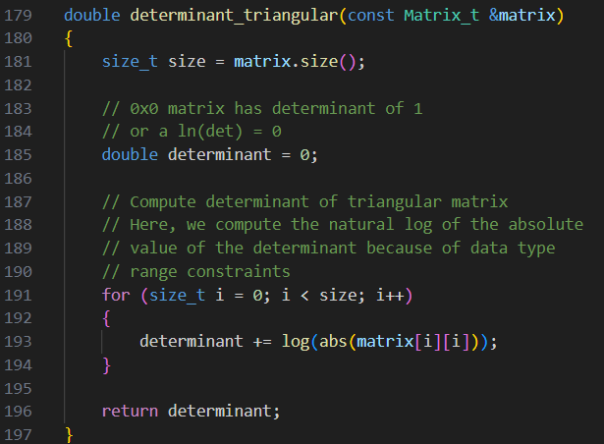
Serial C++ Code

Slide 13
Parallel (Multi-threaded) Approach Explanation
Uses C++ 11 STL <thread>
std::thread
Cross-platform
Language integration
Object-Oriented
Based on the Doolittle Algorithm.
Every thread shares matrix A, L, and U.
Each thread performs a portion of the outermost for-loop.
Each thread computes n / t rows of U, and columns of L where n is the order of a square matrix of n x n size, and t is the number of threads.
*In code, row / column indices begin at 0.
t0
t1
t(n-1)
t0
t1
t(n-1)

Slide 14
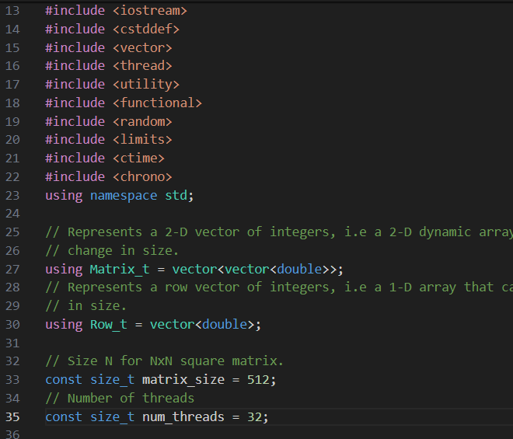
Multi-threaded C++ Code

Slide 15
Multi-threaded C++ Code

Slide 16
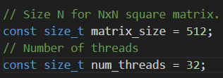
Multi-threaded C++ Code

Slide 17
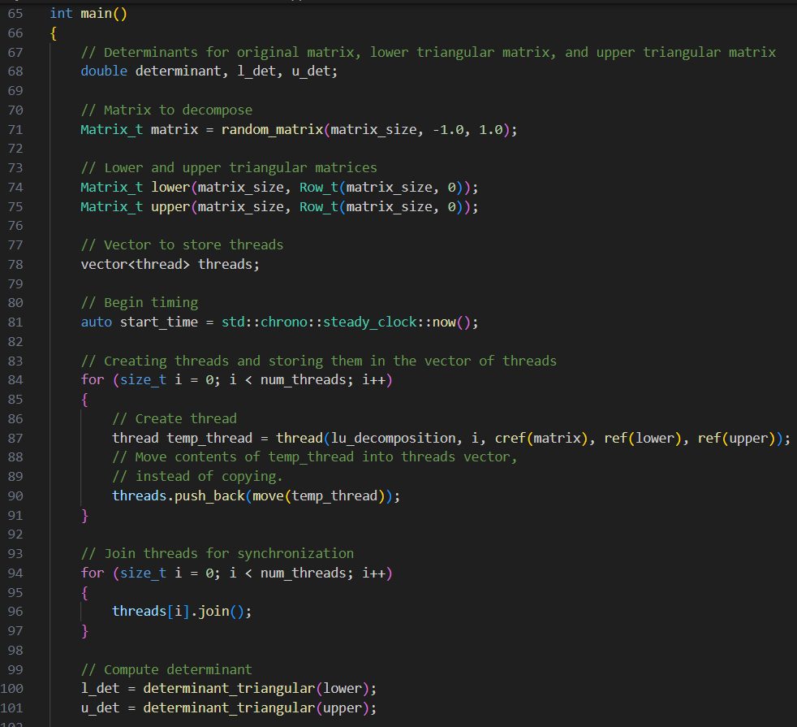
Multi-threaded C++ Code

Slide 18
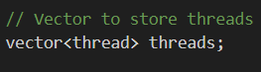
Multi-threaded C++ Code

Slide 19
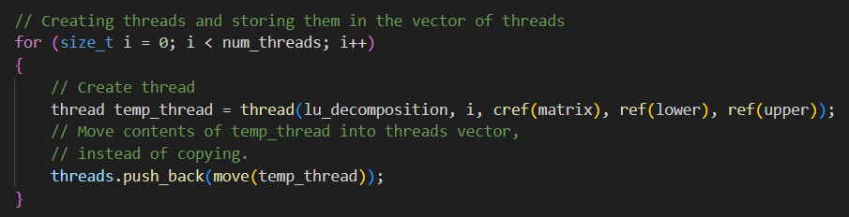
Multi-threaded C++ Code

Slide 20
Multi-threaded C++ Code

Slide 21
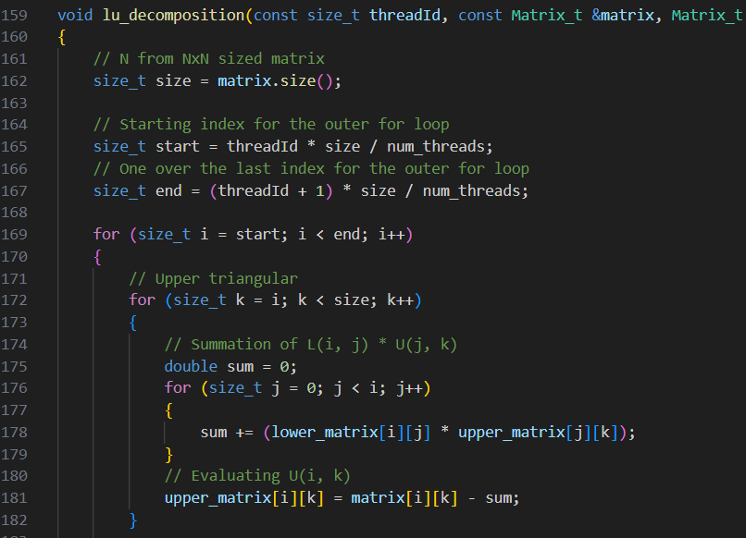
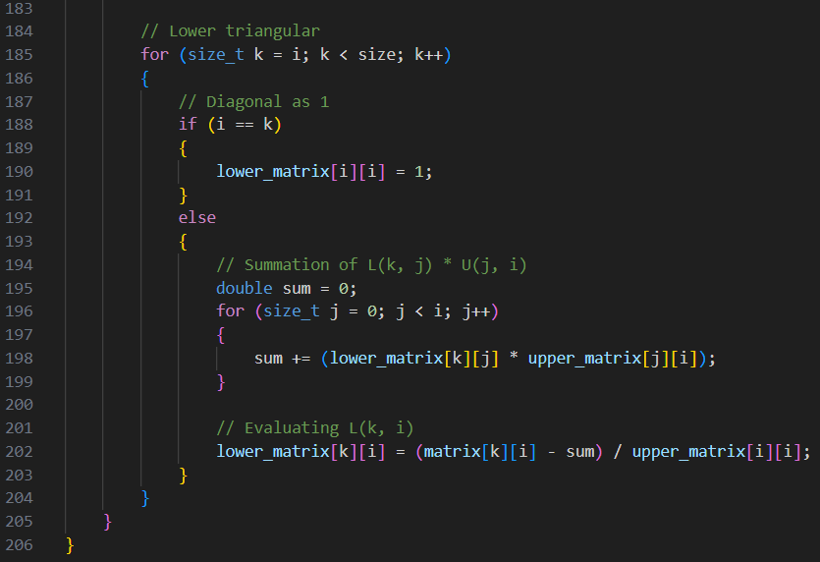
Multi-threaded C++ Code

Slide 22
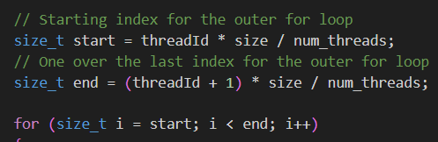
Multi-threaded C++ Code

Slide 23
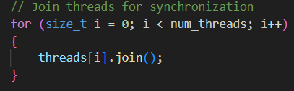
Multi-threaded C++ Code

Slide 24
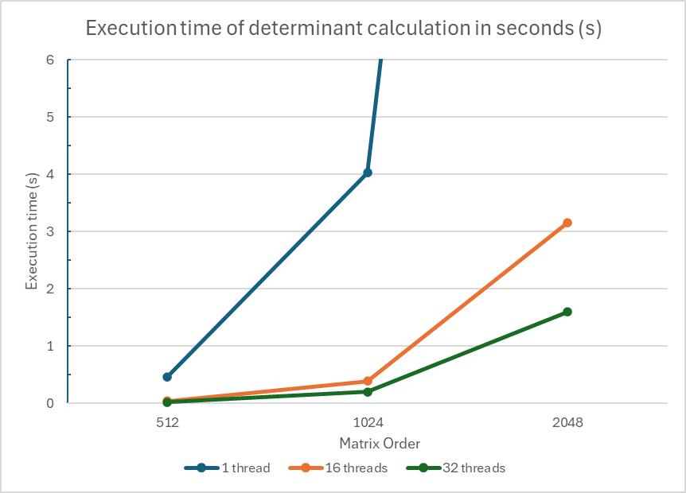
Execution Time
Execution Time in Seconds
 | Order of Matrix
Number of Threads | 512 | 1024 | 2048
1 | 0.463626449 | 4.026737 | 33.30727551
16 | 0.045968253 | 0.390925782 | 3.153950131
32 | 0.02433264 | 0.201477472 | 1.600055011

Slide 25
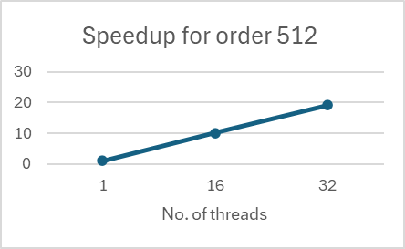
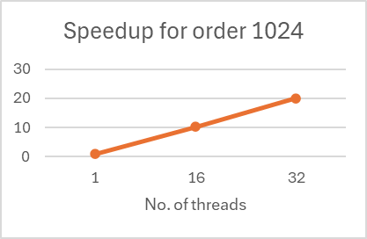
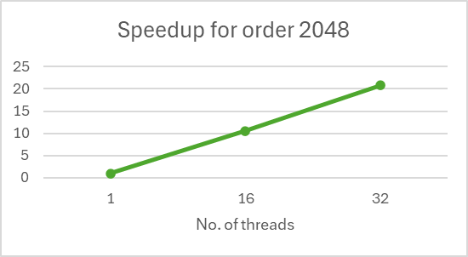
Speedup
Speedup
 | Order of Matrix
Number of Threads | 512 | 1024 | 2048
1 | 1.0 | 1.0 | 1.0
16 | 10.08579652 | 10.30051448 | 10.56049529
32 | 19.05368491 | 19.98603931 | 20.81633149

Slide 26
References:
https://www.geeksforgeeks.org/doolittle-algorithm-lu-decomposition/#
https://math.libretexts.org/Bookshelves/Linear_Algebra/Introduction_to_Matrix_Algebra_(Kaw)/01%3A_Chapters/1.07%3A_LU_Decomposition_Method_for_Solving_Simultaneous_Linear_Equations
https://math.libretexts.org/Bookshelves/Linear_Algebra/A_First_Course_in_Linear_Algebra_(Kuttler)/03%3A_Determinants/3.02%3A_Properties_of_Determinants#thm:addingmultipleofrow
https://www.engr.colostate.edu/~thompson/hPage/CourseMat/Tutorials/CompMethods/doolittle.pdf
https://math.libretexts.org/Bookshelves/Linear_Algebra/Interactive_Linear_Algebra_(Margalit_and_Rabinoff)/04%3A_Determinants/4.03%3A_Determinants_and_Volumes

Slide 27
References:
https://www.mathworks.com/help/matlab/ref/lu.html#d126e954784
https://www3.nd.edu/~zxu2/acms40390F11/Alg-LU-Crout.pdf
https://www.geeksforgeeks.org/thread-in-operating-system/
https://johnfoster.pge.utexas.edu/numerical-methods-book/LinearAlgebra_LU.html

Slide 28
Thank you!
Any questions?

